Slide 1

Infrared Wave-Front Sensors for Adaptive Optics
Siqi Liu
Supervisor: Suresh Sivanandam
Collaborators: Shaojie Chen, Jean-Pierre Veran (NRC), Tim Hardy (NRC), Phil Hinz (Arizona)
G2000 Mar 23, 2016

Slide 2
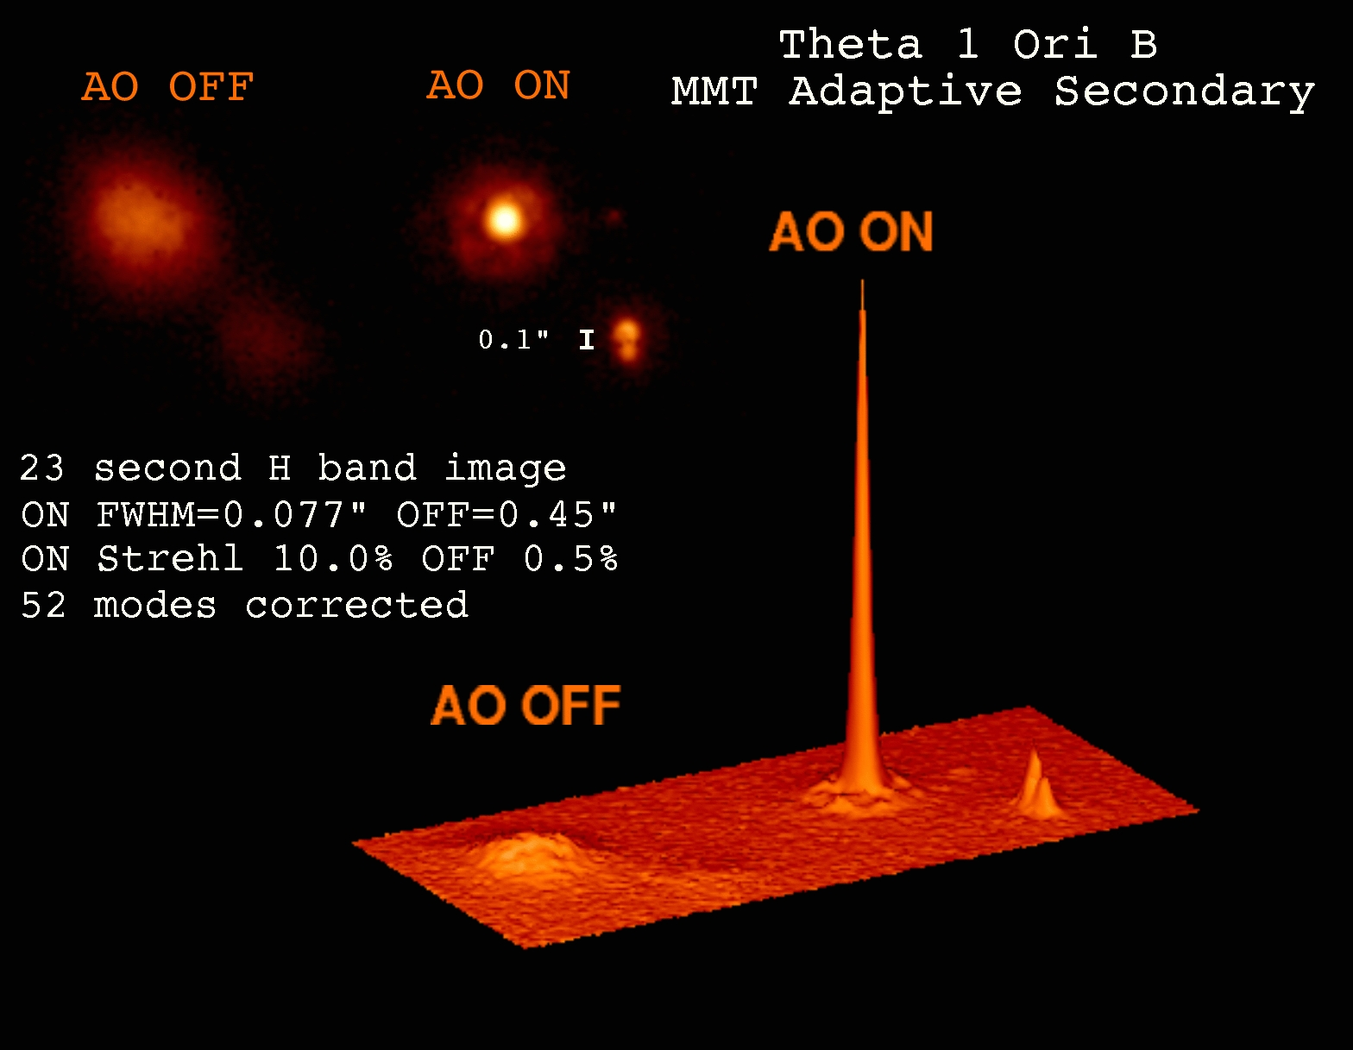
Adaptive Optics
Photo Credit: Laird Close, CAAO, Steward Observatory

Slide 3
Why use the Infrared Wave-Front Sensor for AO?
Better correction for redder objects
e.g. late-type stars(K and M type), obscured objects, and AGN
Increased sky coverage
More late-type stars being detected (more commonly existed)
more guide stars
→ better sky coverage (The fraction of the sky which the system provides a useful level of compensation.)

Slide 4
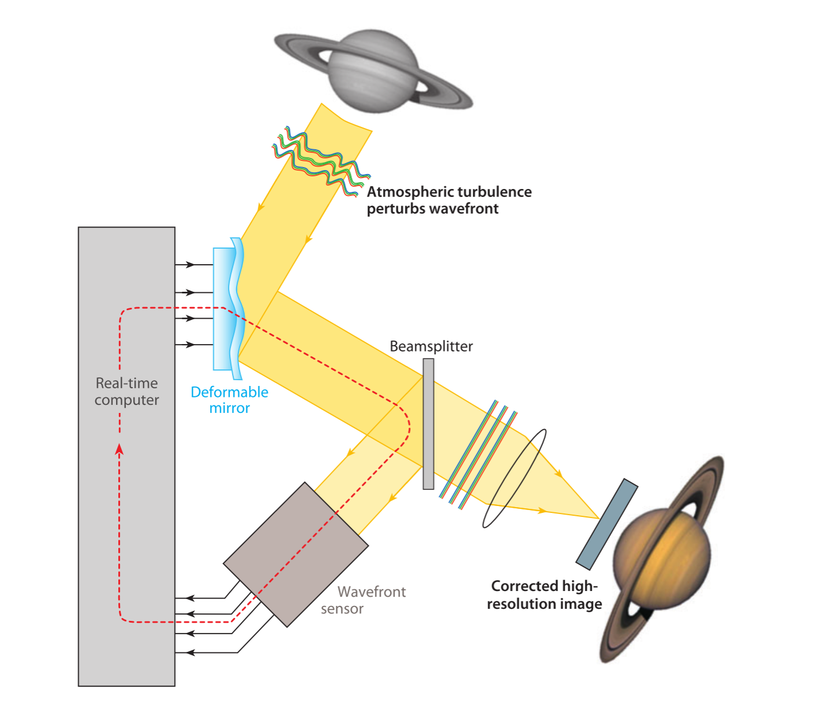
Adaptive Optics
Shack-Hartmann WFS
Pyramid WFS
(Davies and Kasper, 2012)

Slide 5
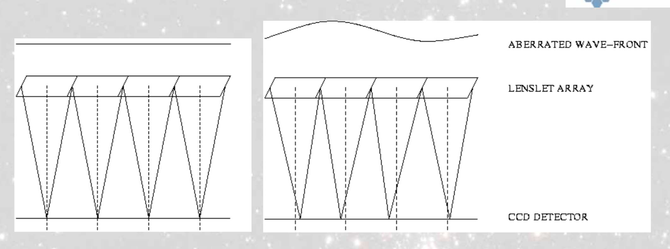
Shack-Hartmann Wave-Front Sensor
(MARCOS VAN DAM and RICHARD CLARE, 2007)

Slide 6
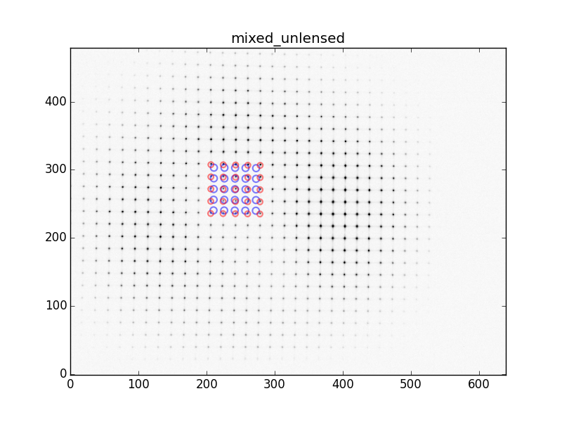
Lab images of the SH Wave-Front Sensor
Red circles: unlensed
Blue circles: lensed

Slide 7
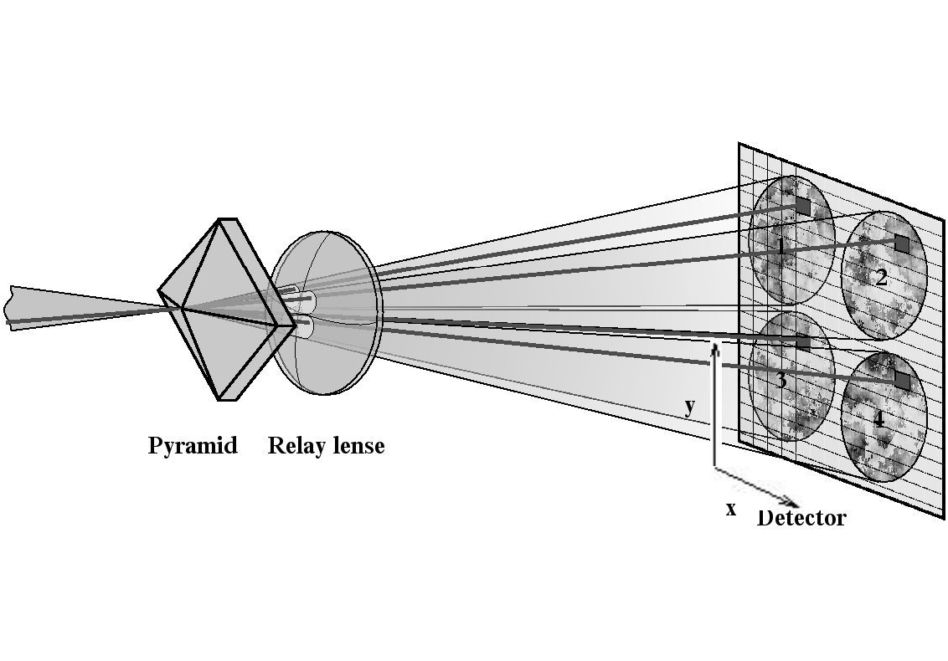
Pyramid Wave-Front Sensor
Courtesy of S. Egner

Slide 8
Lab Results

Slide 9
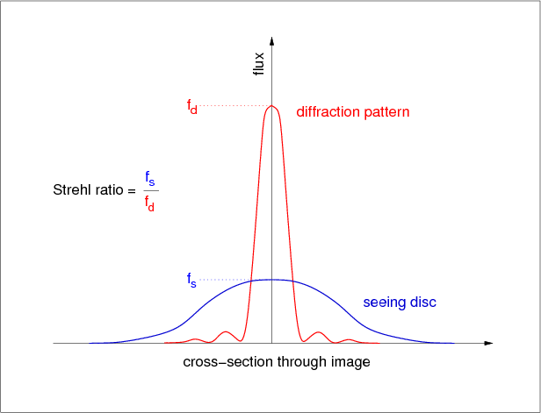
Performance of of 2 wavefront sensors
Strehl Ratio
Reproduced from Fig 68 in http://www.vikdhillon.staff.shef.ac.uk/teaching/phy217/telescopes/phy217_tel_adaptive.html
Observational Band | Shack-Hartmann Wave-Front Sensor | Pyramid Wave-Front Sensor
H band (1.65 microns) | 0.49 | 0.55
K band (2.2 microns) | 0.65 | 0.73
With the setup of the same number of pixels of the detector and a 5 mag star using Multi-Mirror Telescope.

Slide 10
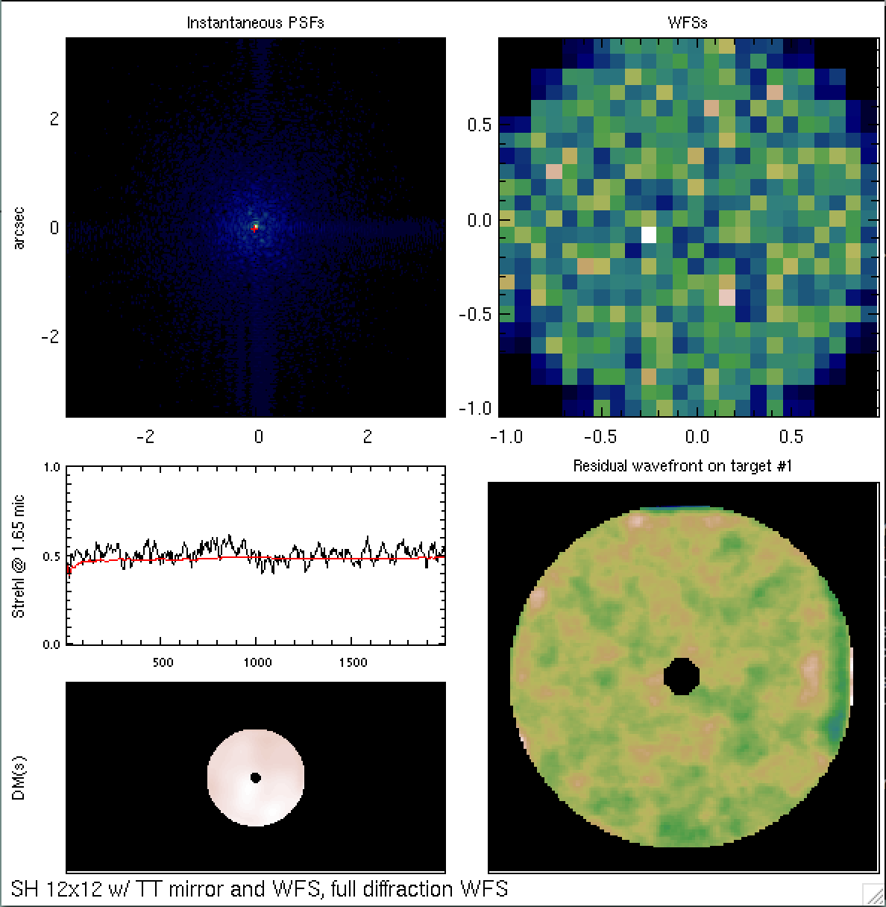
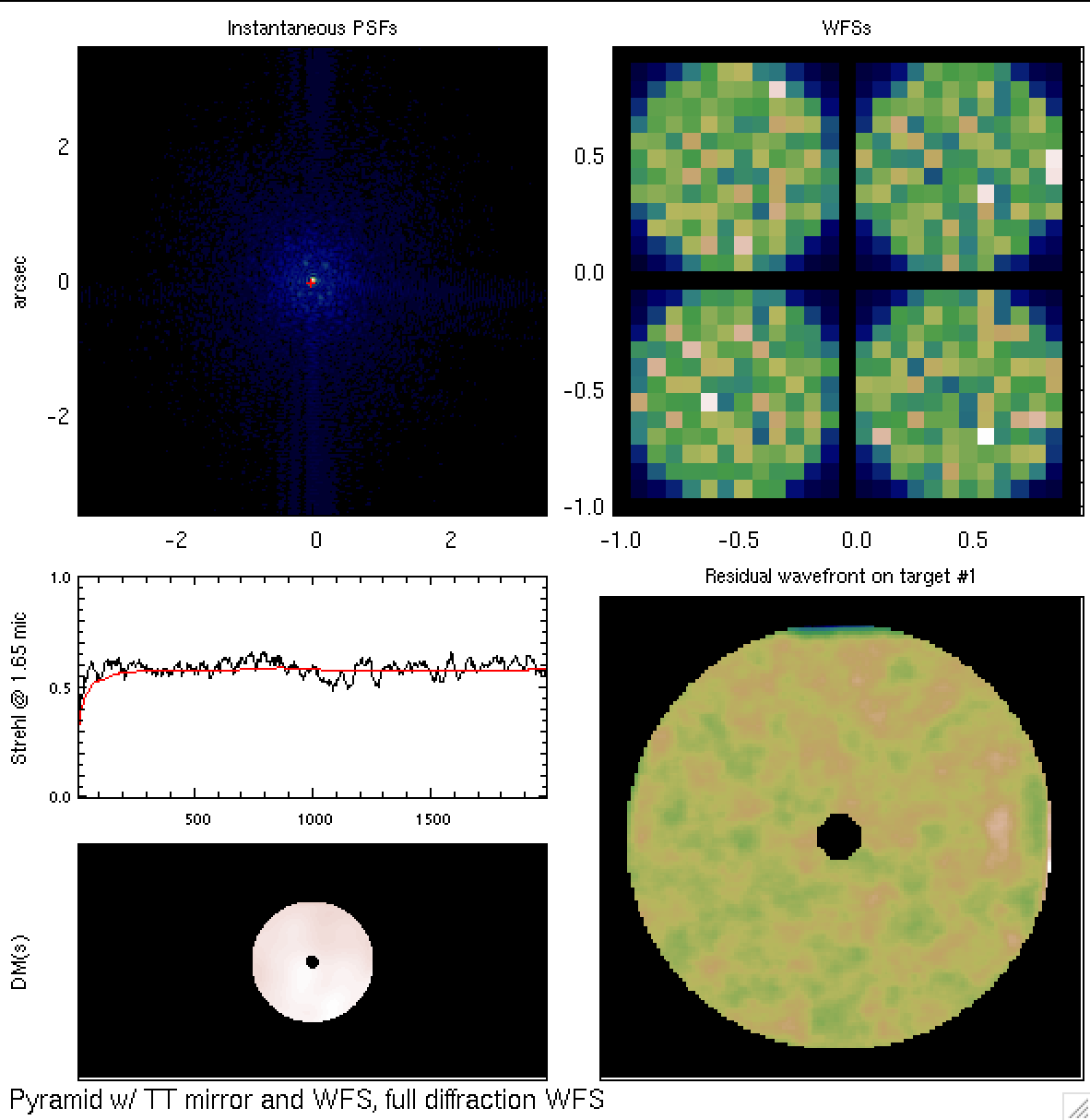
Simulation display
Shack-Hartmann WFS
Pyramid WFS

Slide 11
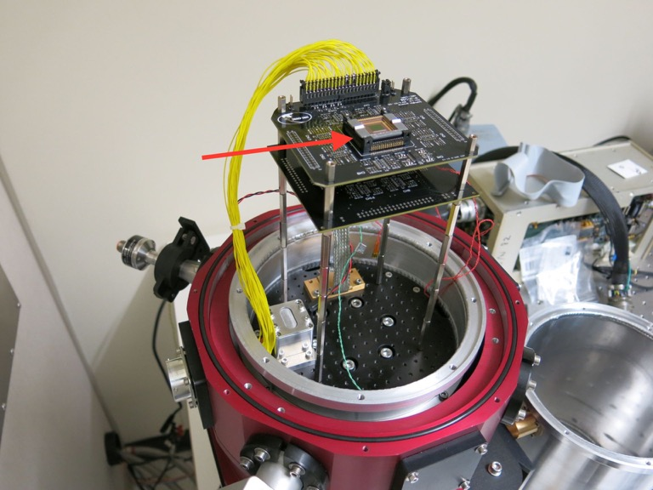
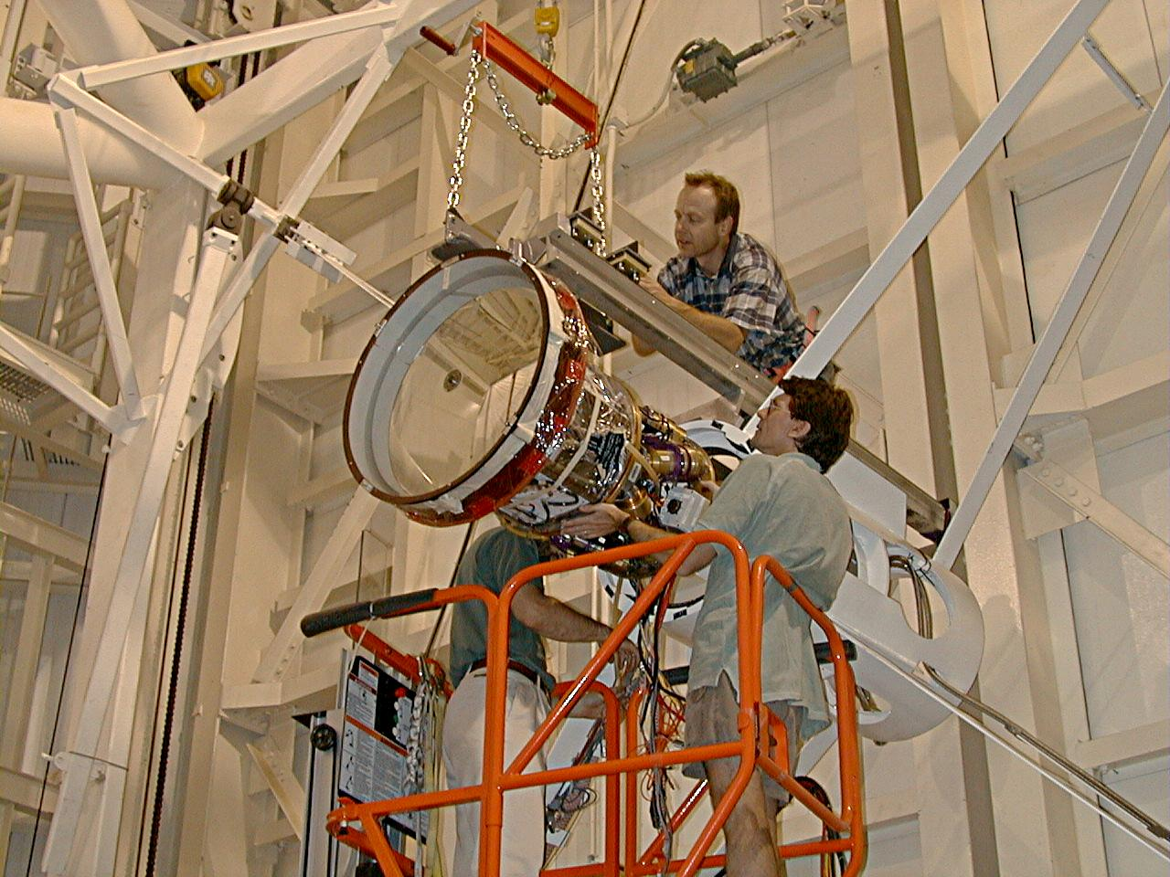
Our detector
Deformable Mirror
Less than 1e read out noise.
MMT

Slide 12
